Slide 1
物聯網實務 HW4
電機碩一 11278008 林佳慧
日期:2023/10/04

Slide 2
Exercise 4-1
Test Object.keys() in Node-RED

Slide 3
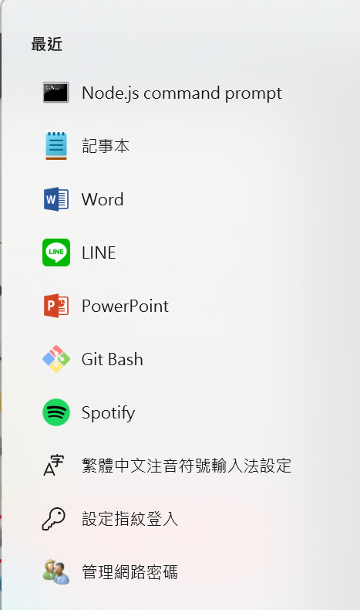
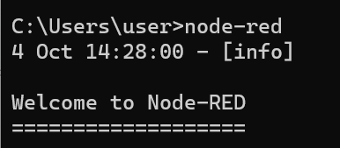
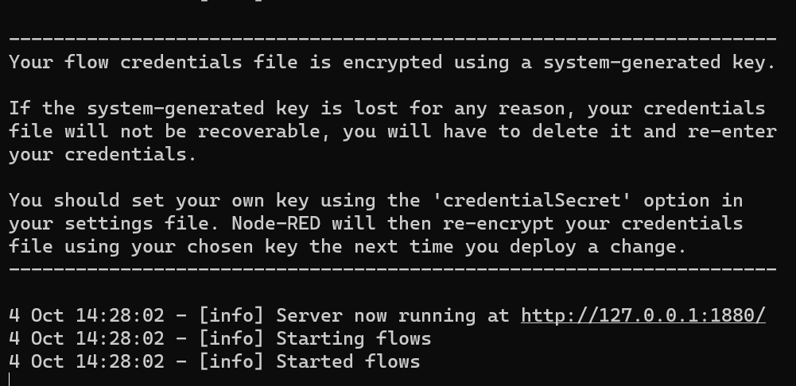

Slide 4
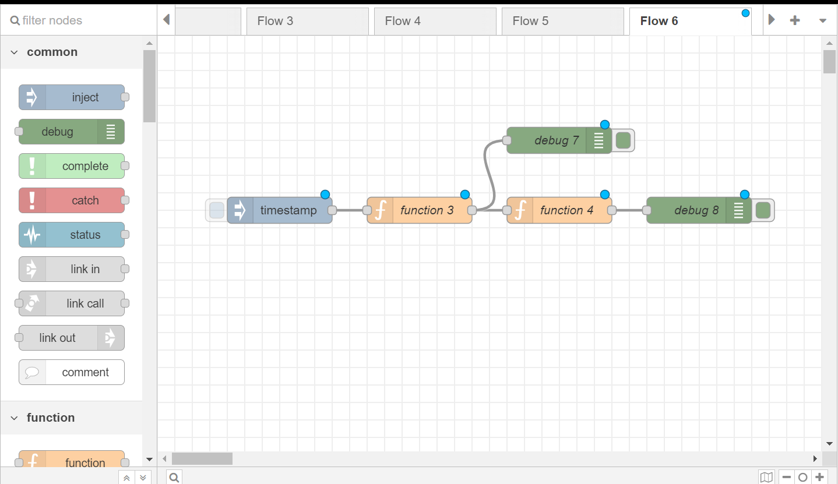

Slide 5
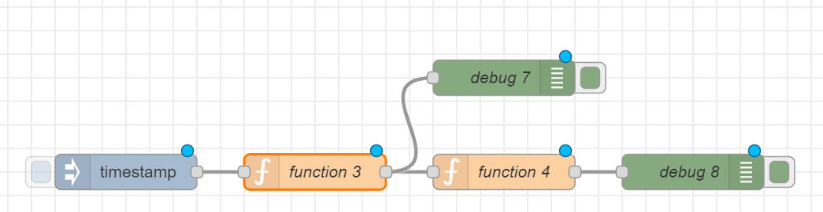
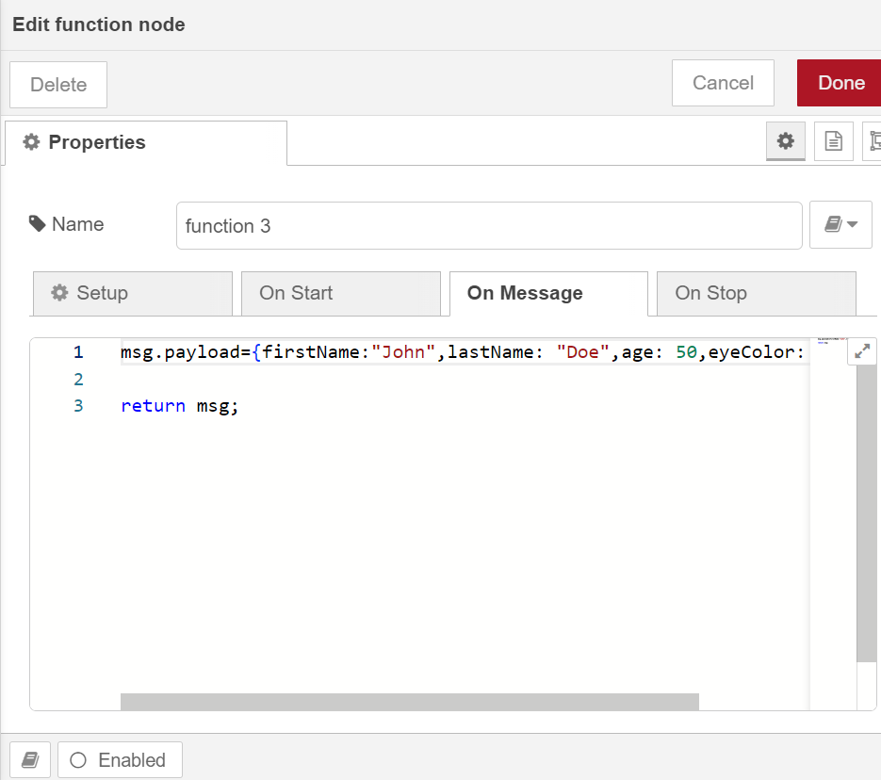
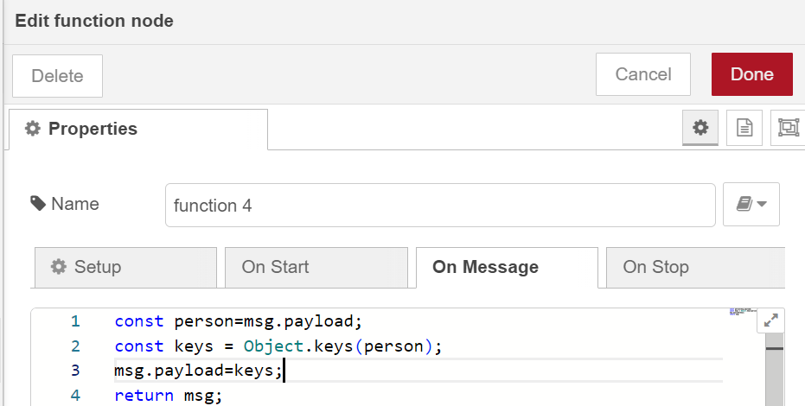

Slide 6

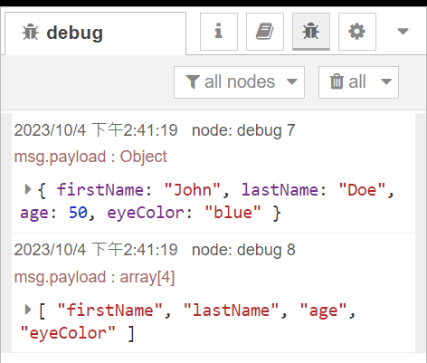
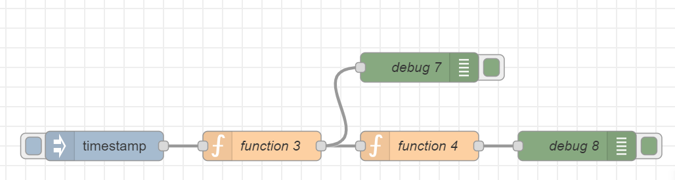

Slide 8
Exercise 4-2
Test Object.values() in Node-RED

Slide 9
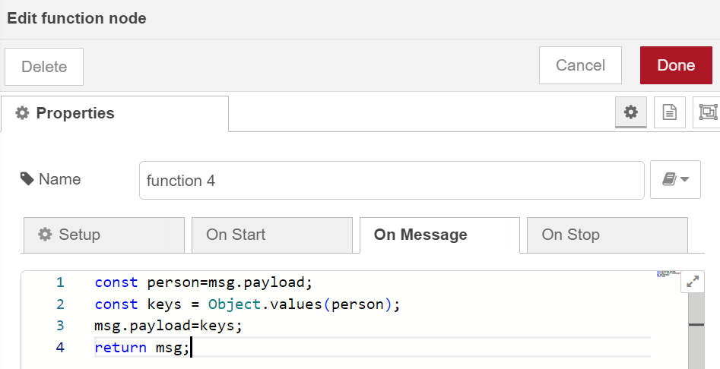
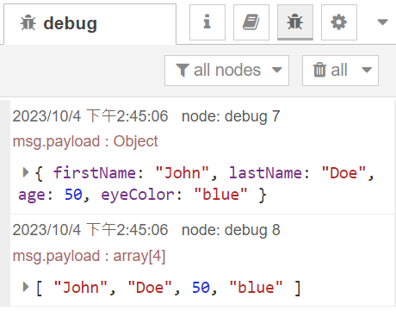

Slide 10
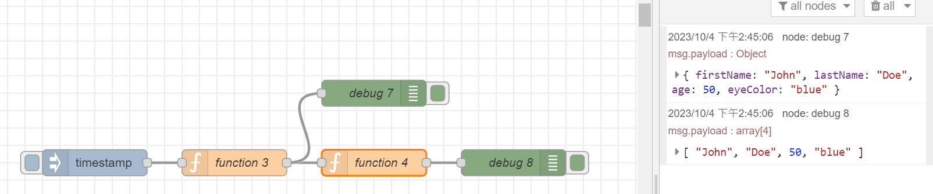

Slide 12
Exercise 4-3
Design of a voting system

Slide 13
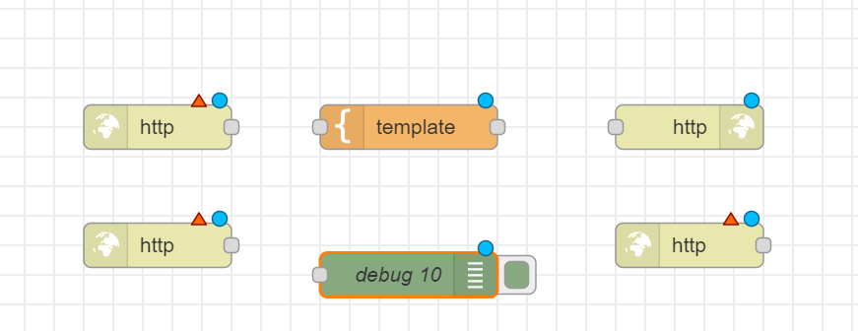

Slide 14
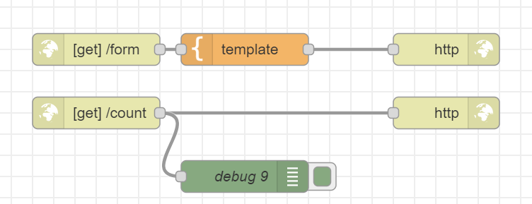
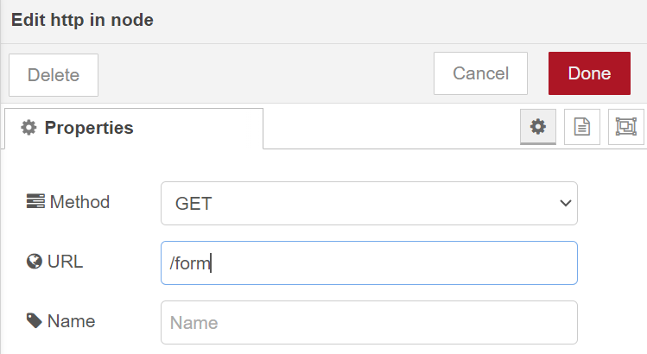
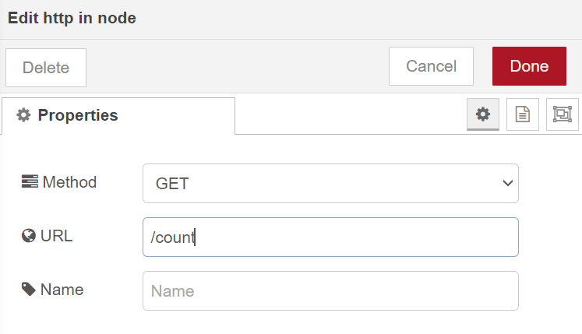

Slide 15
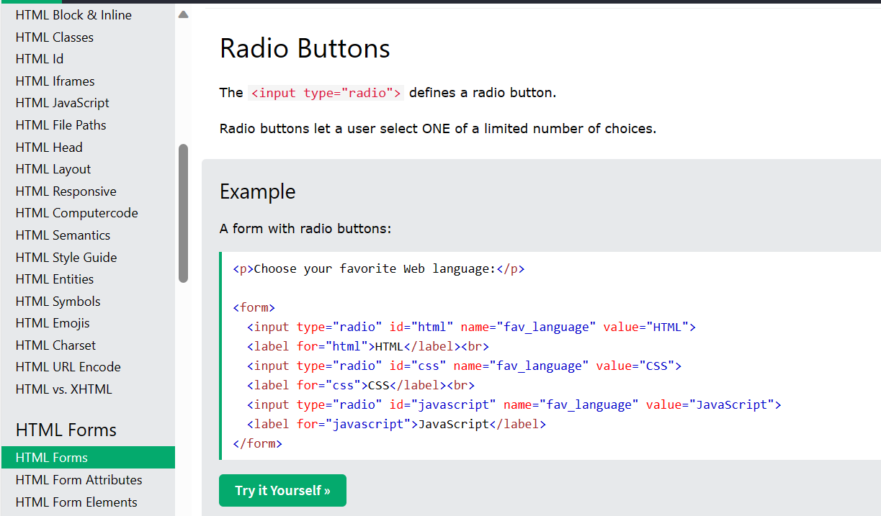
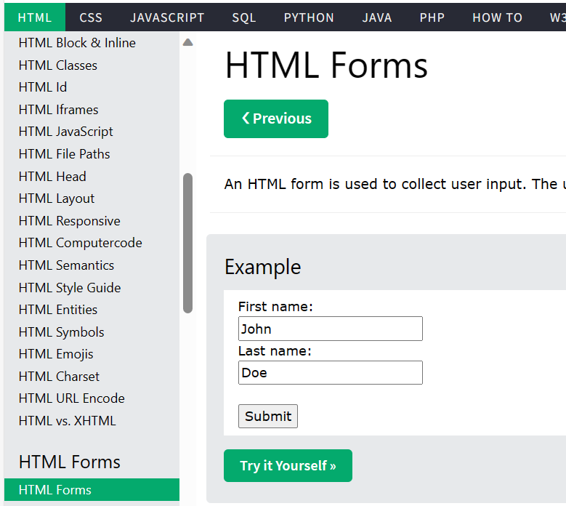

Slide 16
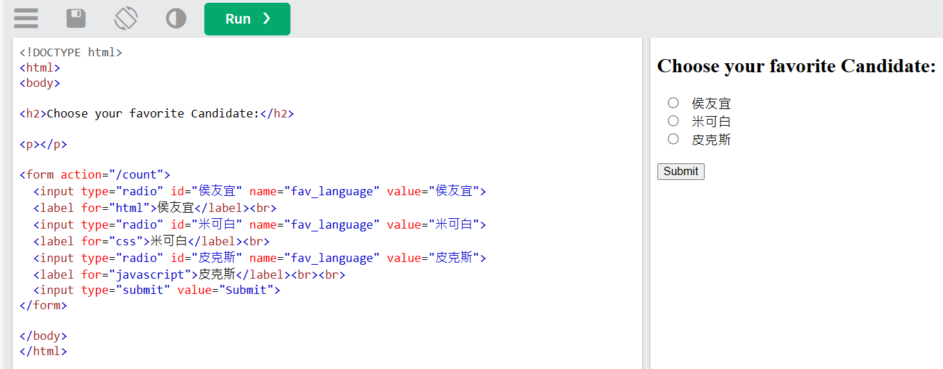

Slide 17
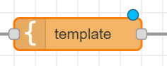
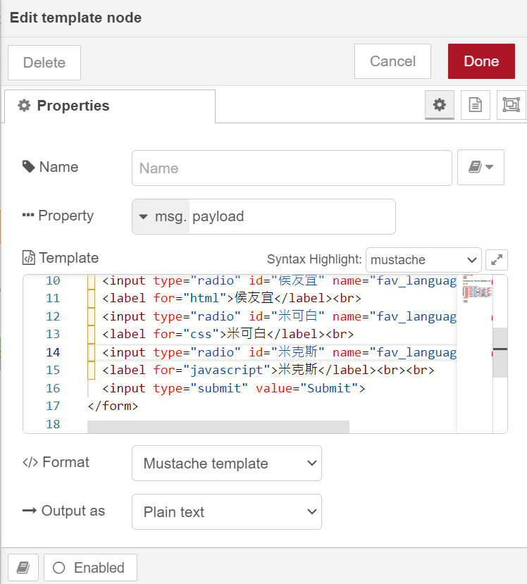

Slide 18

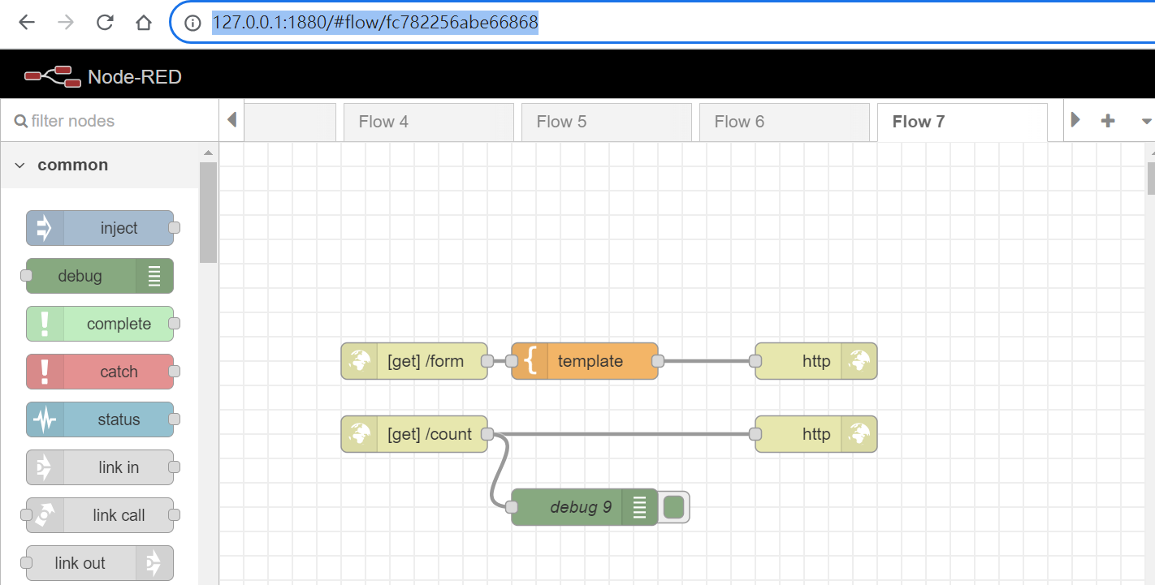

Slide 19
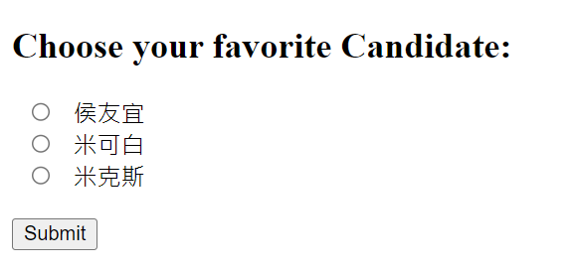
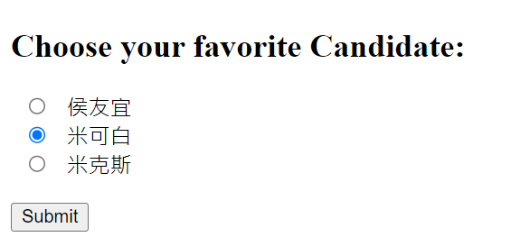
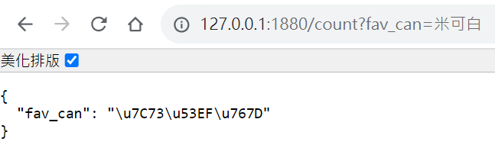
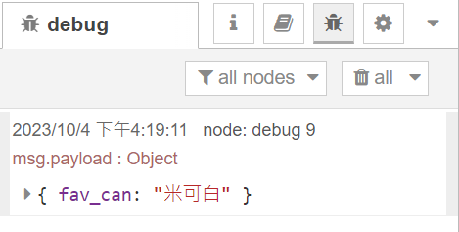

Slide 20
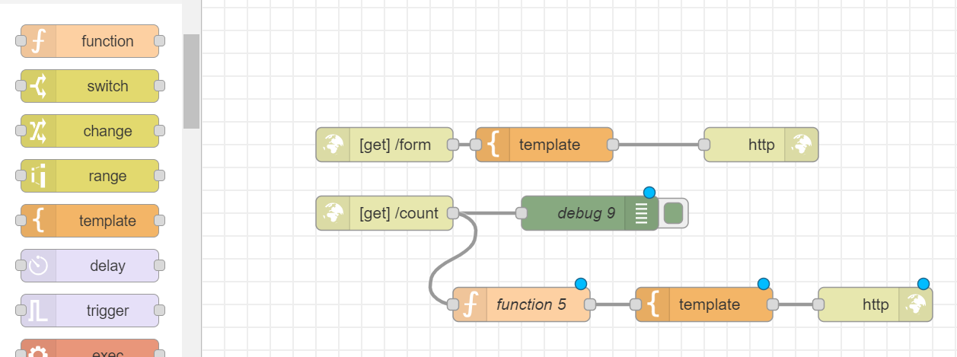

Slide 21
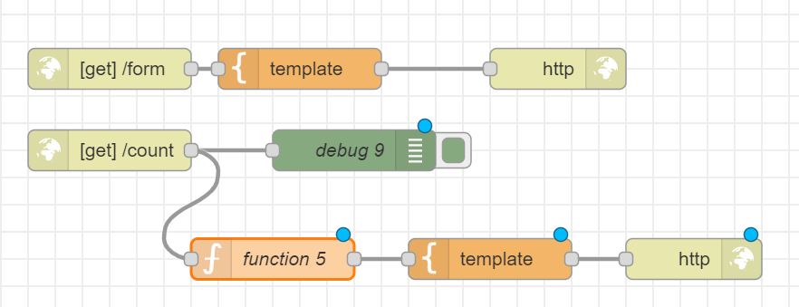
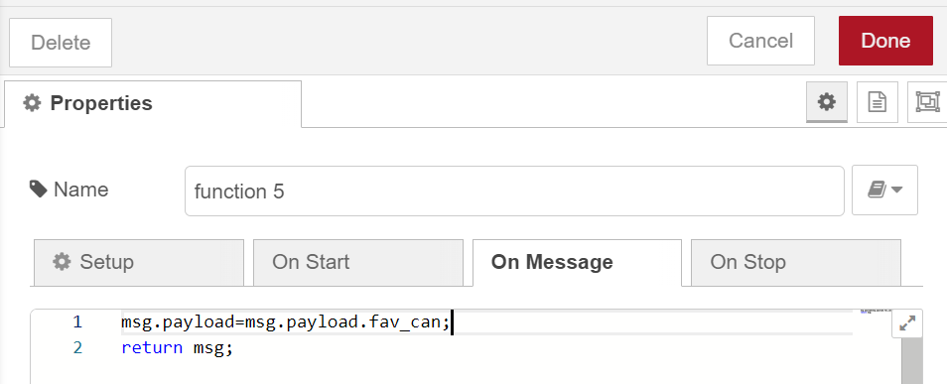
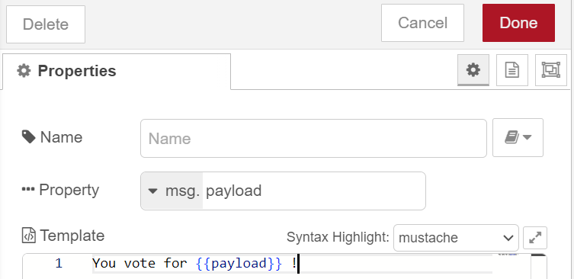

Slide 22
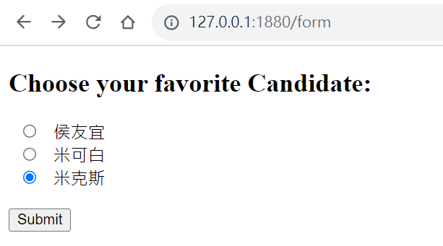
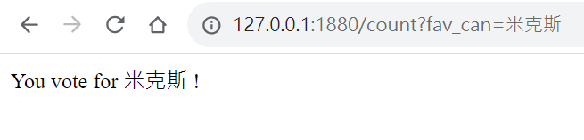

Slide 28
Exercise 4-4
Evaluate the voting results

Slide 29
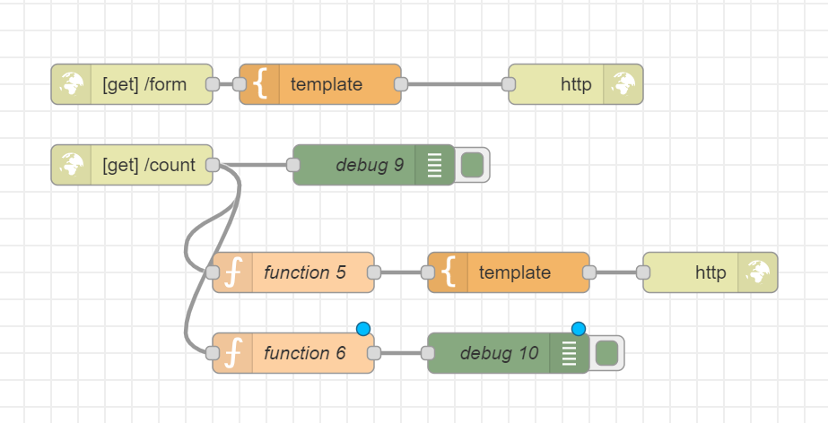

Slide 30
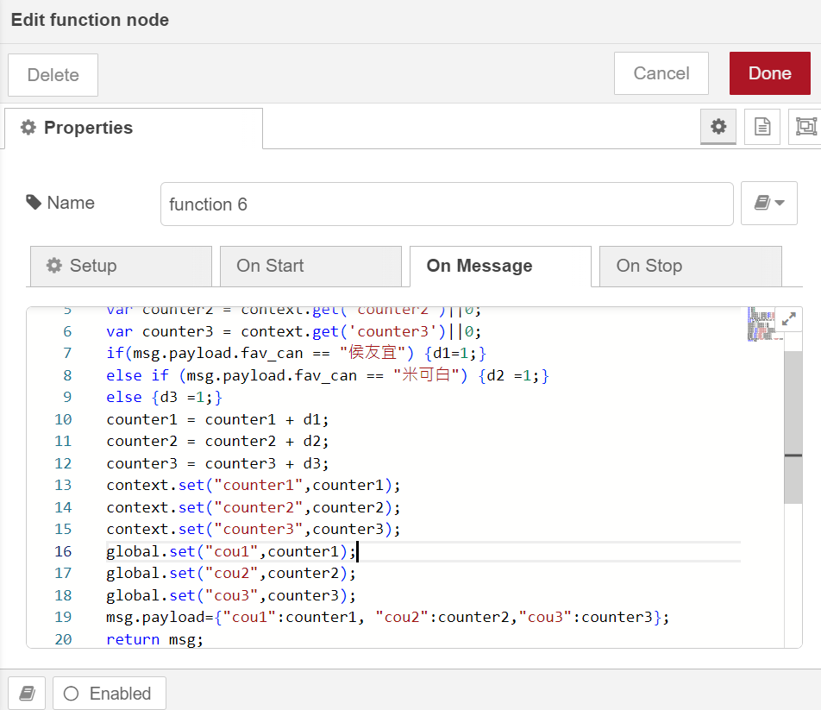

var d1=0;
var d2=0;
var d3=0;
var counter1 = context.get('counter1')||0;
var counter2 = context.get('counter2')||0;
var counter3 = context.get('counter3')||0;
if(msg.payload.fav_can == "侯友宜") {d1=1;}
else if (msg.payload.fav_can == "米可白") {d2 =1;}
else {d3 =1;}
counter1 = counter1 + d1;
counter2 = counter2 + d2;
counter3 = counter3 + d3;
context.set("counter1",counter1);
context.set("counter2",counter2);
context.set("counter3",counter3);
global.set("cou1",counter1);
global.set("cou2",counter2);
global.set("cou3",counter3);
msg.payload={"cou1":counter1, "cou2":counter2,"cou3":counter3};
return msg;

Slide 31
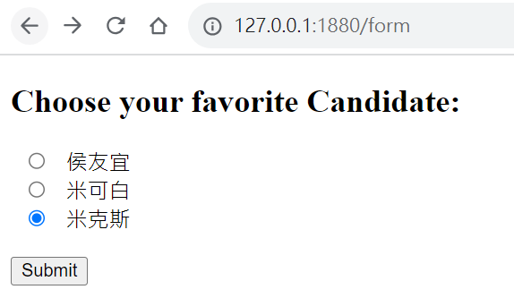
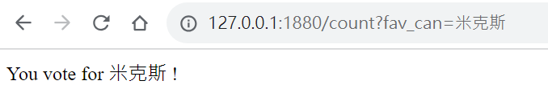
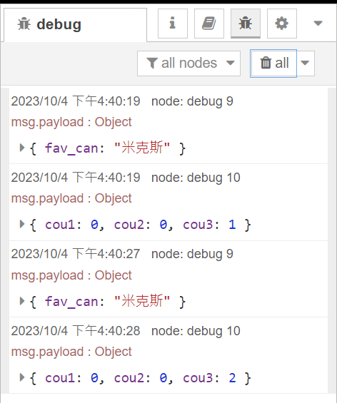
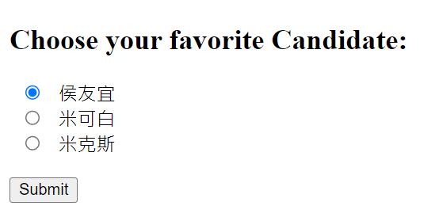
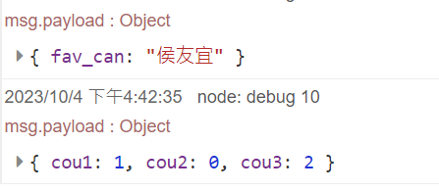

Slide 32
Exercise 4-5
Visualize the voting results

Slide 33
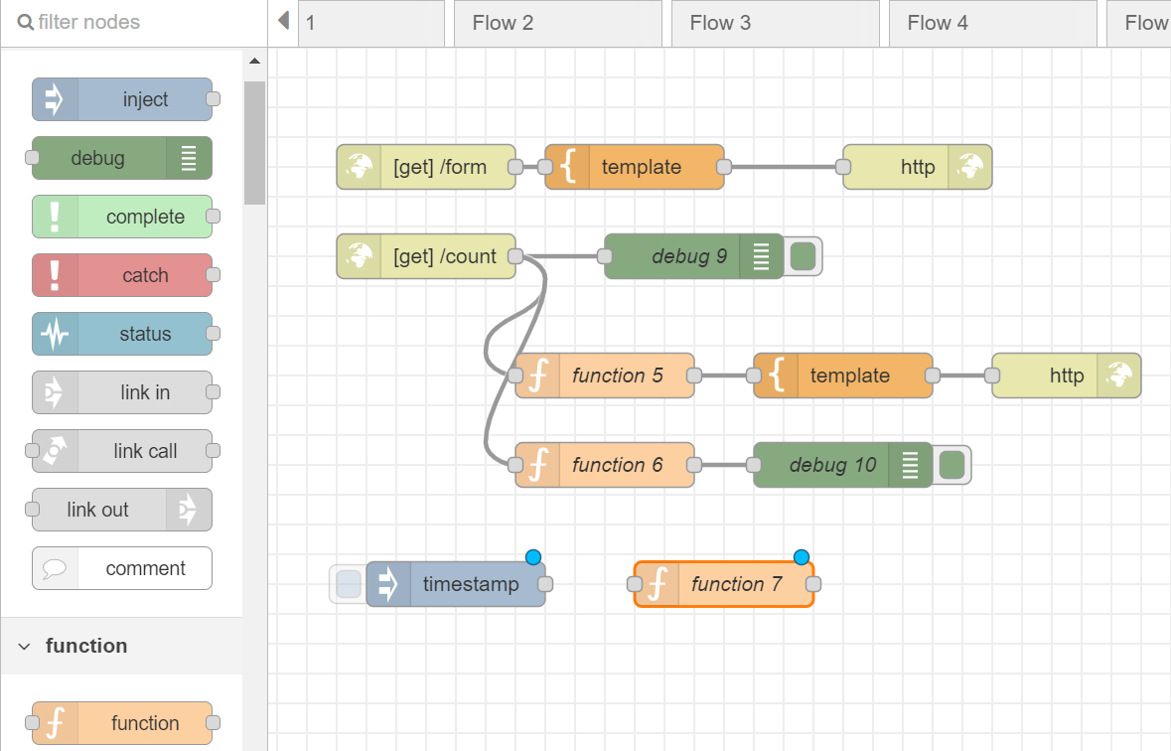

Slide 34
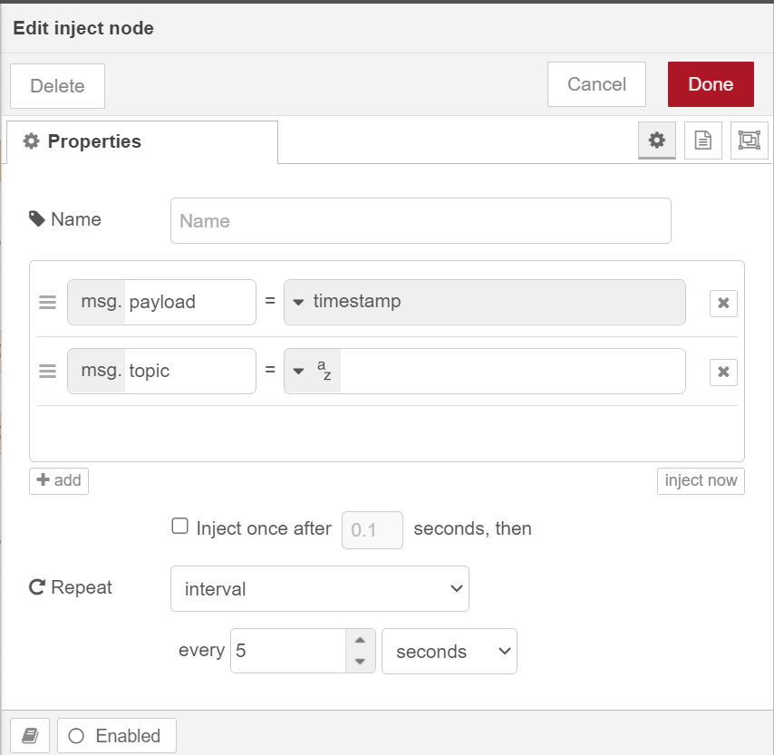
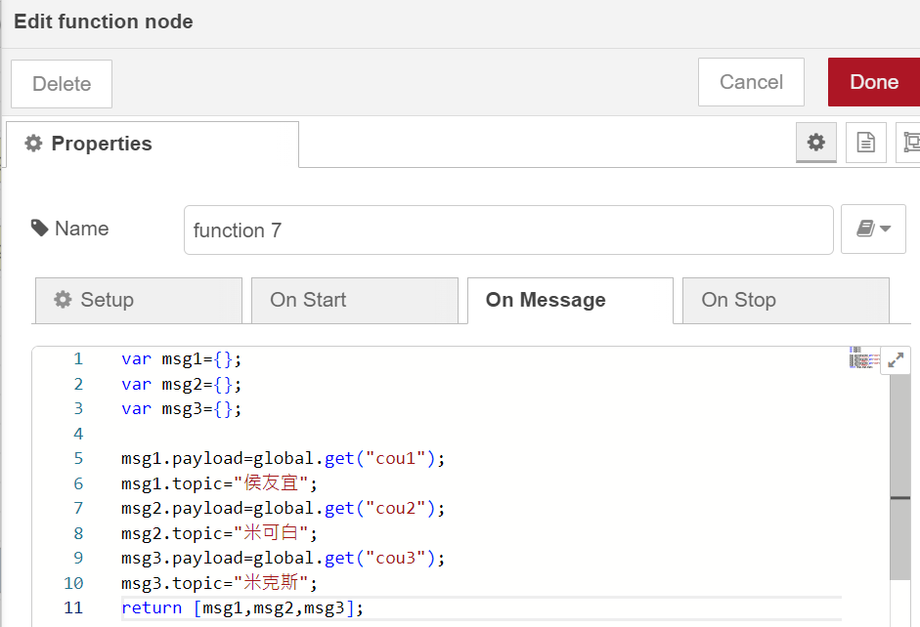

Slide 35
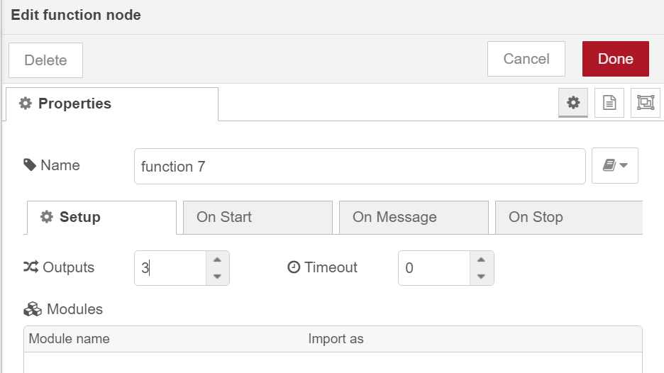
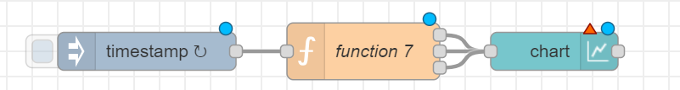

Slide 36
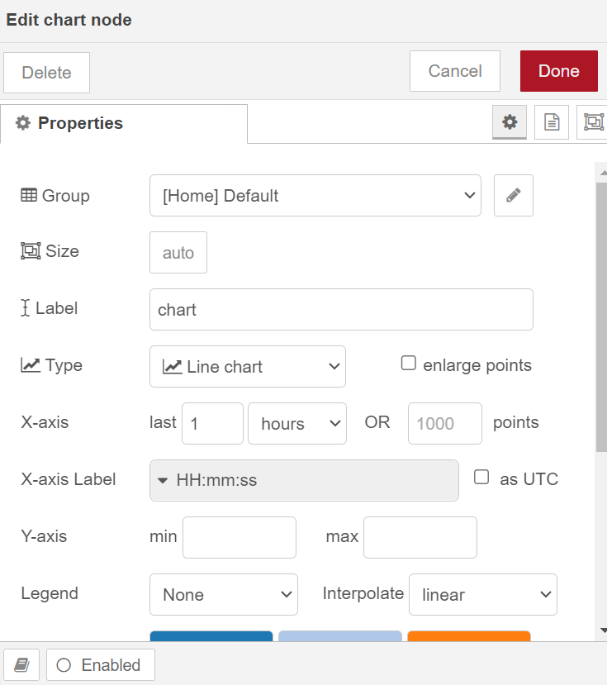
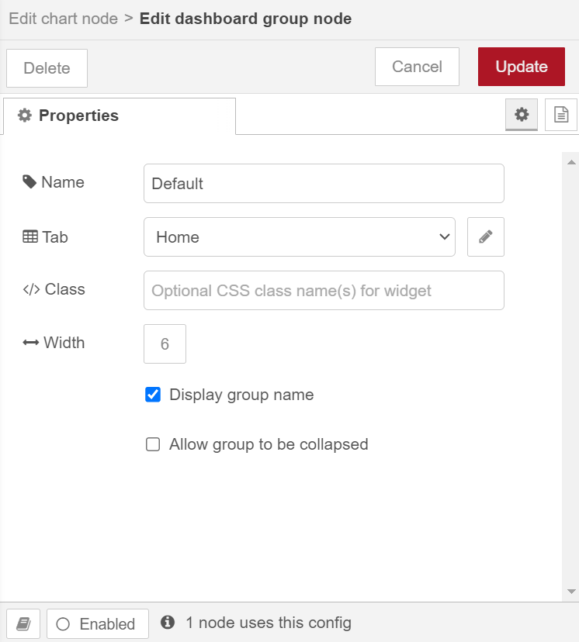

Slide 37
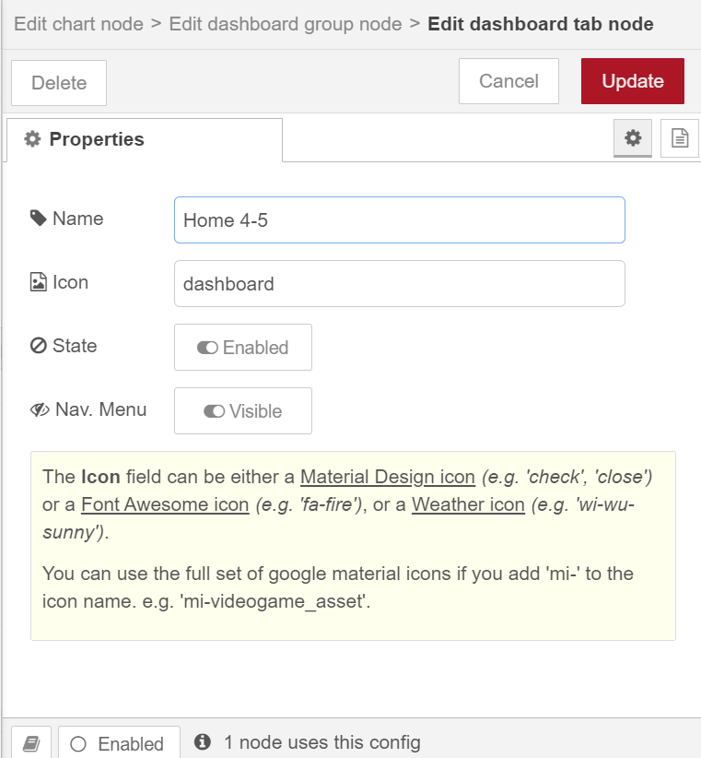
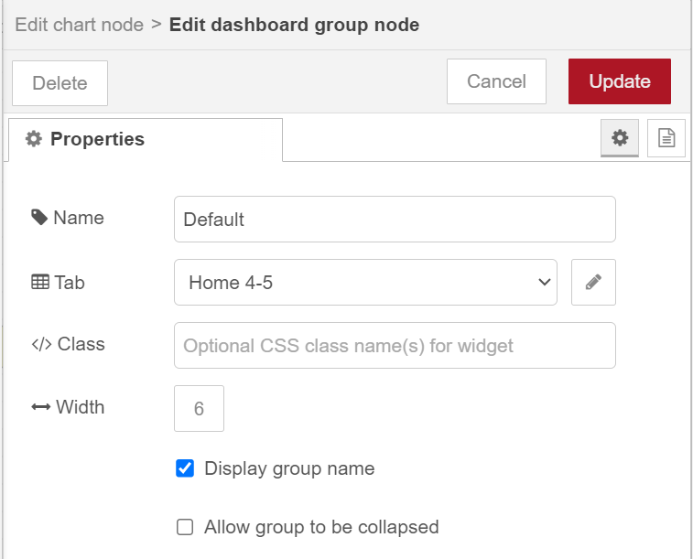

Slide 38
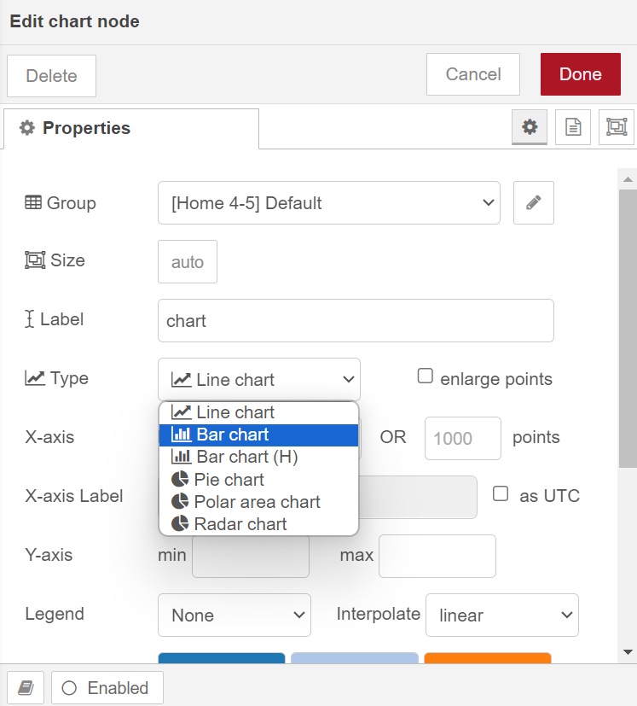
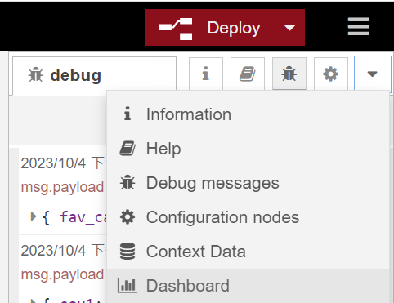


Slide 39


Slide 40
Homework 4-1
For an object : {firstName:"John",lastName:"Doe",age:50,eyeColor:"blue"}
Change the last one value to "red"

Slide 41



Slide 45
Homework 4-2
Print the value of mag data when the mag > 4

Slide 46


Slide 47





Slide 48


Slide 49


Slide 50


Slide 51



Slide 54
Homework 4-3
Design a voting system for four candidates.

Slide 61


1. 到Node-RED網站https://nodered.org/
2. 下滑點選Getting started

Slide 62

1. 在雲端FlowFuse建立新的Flow
4. 左側拉入http response
2. 左側拉入http in
3. 左側拉入function

Slide 63



5. 更改為/apitest
5. 更改為/msg.payload=“hello”

Slide 64



6. 點擊Deploy
Receive a HTTP get request
msg.payload="hello";
Send the response
7. 複製當前網址並將上/apitest
This is the response from the server built in FlowFuse

Slide 65
Exercise 3-2
• Send the http request with local Node-RED environment

Slide 66

1. Run Node-RED輸入指令(node-red)

